Slide 1

A Deep Dive into O-list Marketplace Performance
By Group 5

Slide 2
Project Overview & Objectives
Goal: Analyze the Brazilian e-commerce landscape to optimize logistics and sales performance.
Dataset: 100k+ orders (2016-2018) across 9 unique tables (Customers, Orders, Payments, etc.).
Tech Stack: * Excel: Initial data exploration, cleaning and quick profiling.
SQL: Data joining, filtering, and complex aggregations.
Power BI / Tableau: Interactive dashboarding and visualization.

Slide 3
Data Cleaning Process
Handling Nulls: Identified missing values in product_category_name , Categorized missing labels as "Unknown.“
Date Normalization: Converted timestamp strings into standard DATETIME formats in SQL to calculate delivery lead times.
Translation: Used a mapping table to convert Portuguese product categories to English for better stakeholder readability.
Duplication: Cleaned the geolocation dataset by removing redundant lat/long coordinates for the same zip code prefixes.

Slide 4
Challenges Faced
Relational Complexity: Linking 8 different tables required a robust Star Schema to avoid "many-to-many" relationship errors in Power BI/Tableau.
Geospatial Noise: The geolocation file was massive and contained outliers (coordinates outside Brazil). Filtered using excel.
The Challenge: Calculating true delivery performance was difficult because the dataset contains multiple timestamps: order_purchase_timestamp, order_approved_at, order_delivered_carrier_date, and order_delivered_customer_date. Created a logic-gate in Excel to ensure the Lead Time KPIs were accurate.
Analytical Hurdle: Reporting on 70+ categories made charts unreadable and cluttered. grouped those 70+ categories into 10-12 major departments.

Slide 5
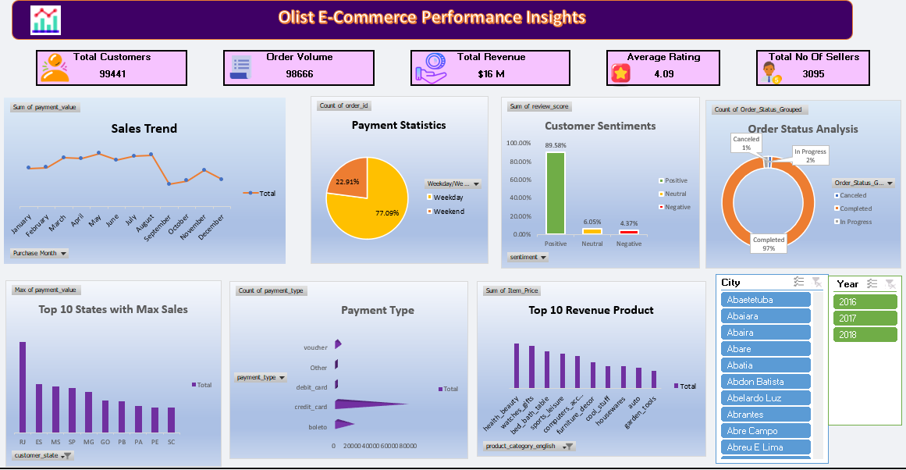
Excel Dashboard

Slide 6
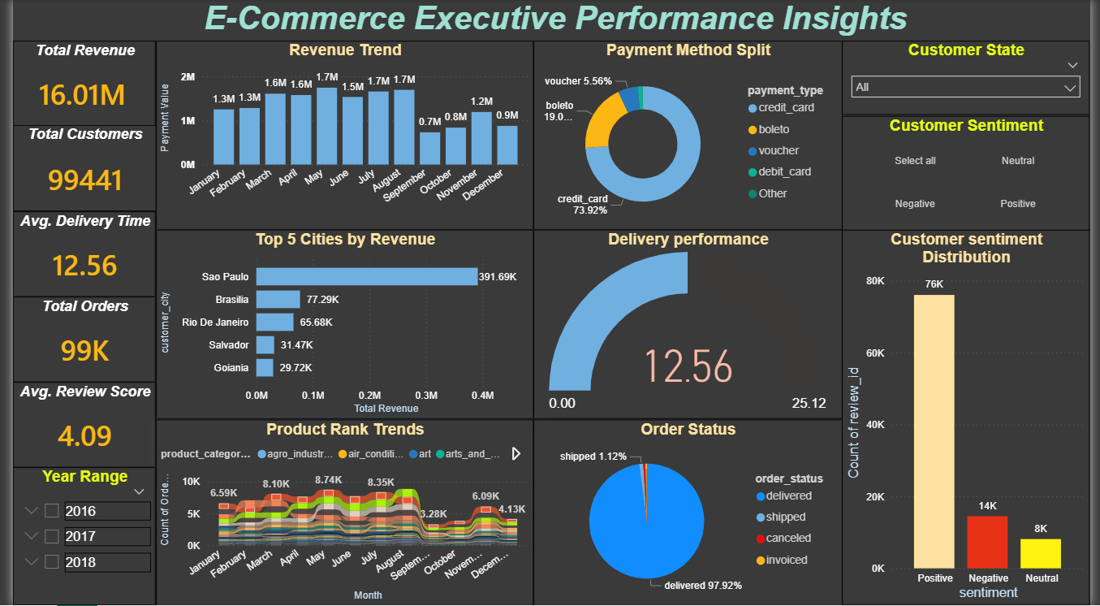
Power BI Dashboard

Slide 7
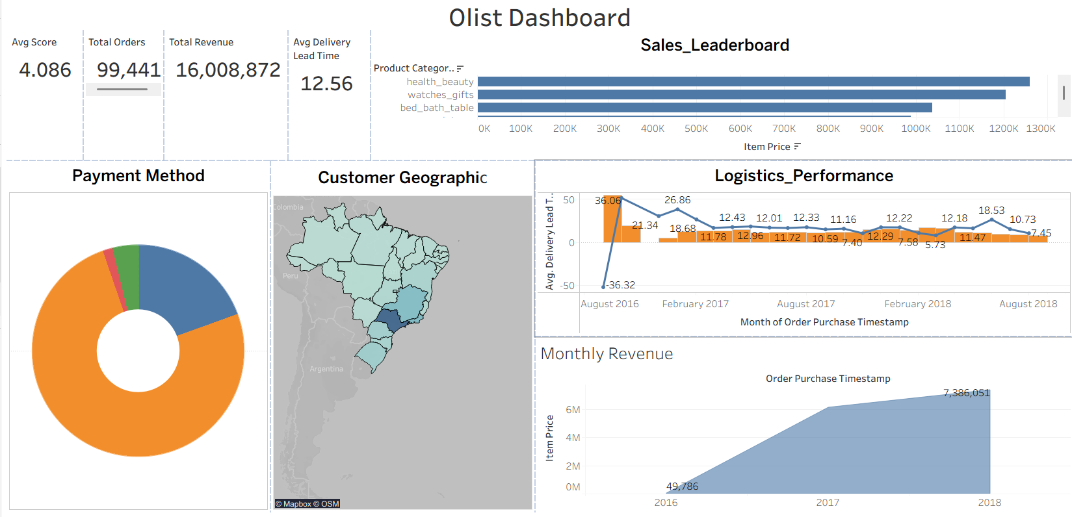
Tableau

Slide 8
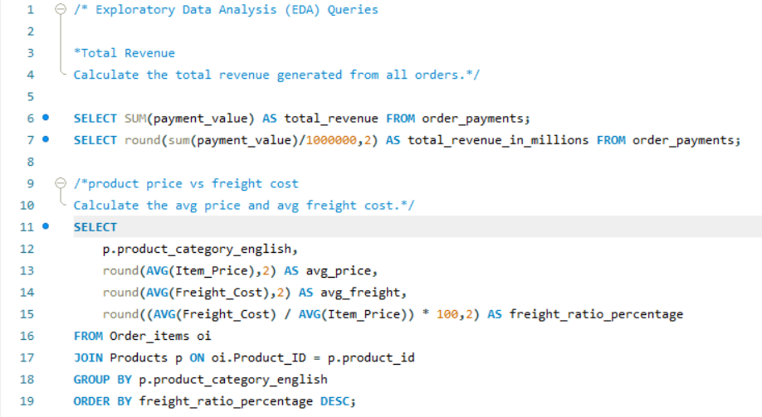
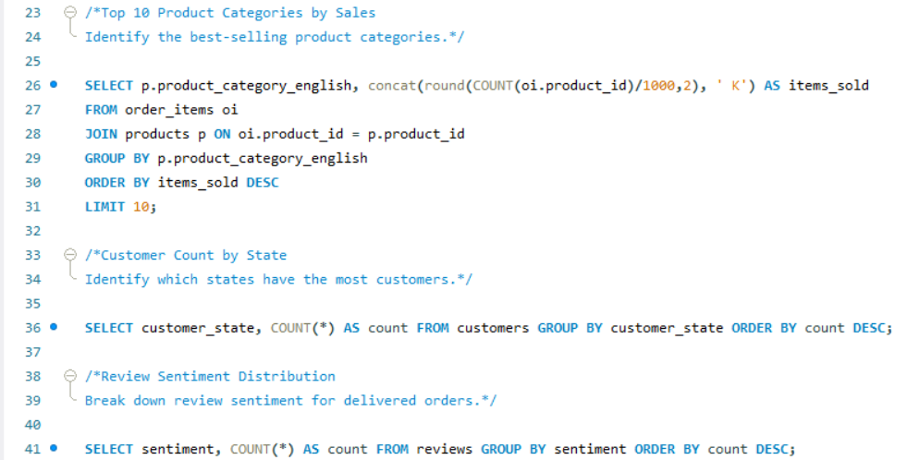
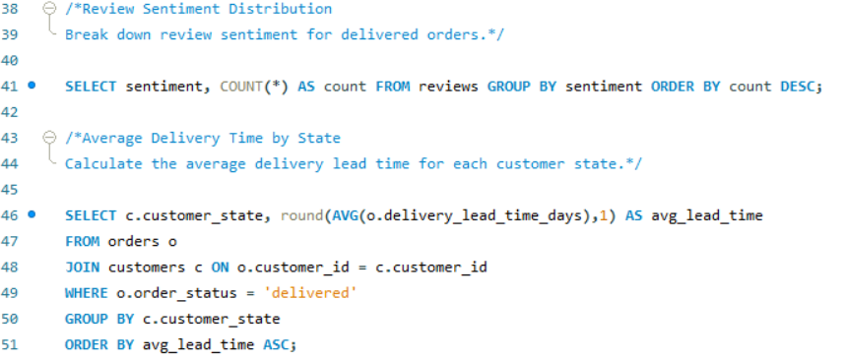
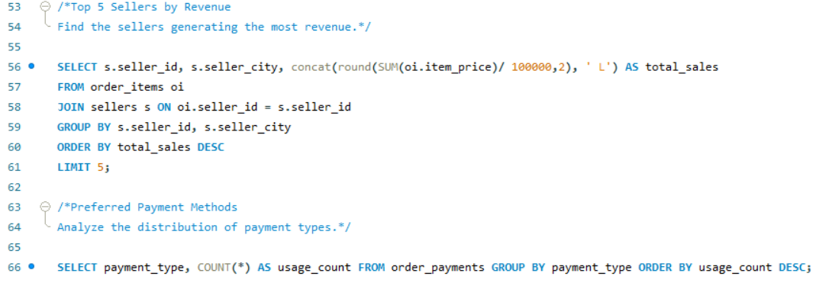
SQL

Slide 9
Key Insights & Findings
Sales Concentration: ~70% of total revenue is generated from three states: São Paulo (SP), Rio de Janeiro (RJ), and Minas Gerais (MG).
Logistics Bottleneck: The average delivery time is ~12 days, but "North" region orders often exceed 20 days, impacting review scores.
Payment Behavior: Credit Card is the dominant payment method (~75%), with a significant preference for installments.
Top Categories: "Health & Beauty" and "Watches/Gifts" yield the highest average order value.

Slide 10
Recommendations & Conclusion
Regional Strategy: Expand regional distribution centers in the North/Northeast to reduce shipping lead times.
Customer Retention: Implement a loyalty program for "Boleto" (cash) users to convert them to more frequent credit card shoppers.
Review Response Automation: Developing an automated outreach system for any customer who leaves a 1 or 2-star rating can improve brand sentiment and prevent negative social proof.
Onboarding Assistance: Provide data-driven insights to new sellers about which zip codes have the highest demand for their specific product category, helping them optimize their initial inventory.

Slide 11
Thank You

